Slide 1

TUGA IT 2017
LISBON, PORTUGAL
From zero to hero
Learn how to automate from the GUI
@Jaap_Brasser

Slide 2





THANK YOU TO OUR SPONSORS

Slide 3









PARTICIPATING COMMUNITIES
CLOUD
PRO
PT

Slide 4
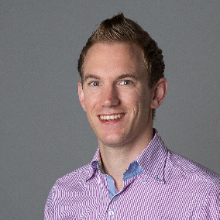
PowerShell Fanatic
GitHub
PowerShell Gallery
TechNet Gallery
@Jaap_Brasser
whoami.exe /priv
Jaapbrasser.com/about

Slide 5
Agenda
How to use PowerShell logging
Demo – Setup PowerShell logging
Demo – PowerShell logging to expose Server Manager
Demo – Use ProcMon to log and automate
Summary and Questions

Slide 6

Agenda
Differences between editors
Configure VSCode
Working with Vscode
Setting up the ISE
Working with the ISE and ISESteroids
Questions
What is
PowerShell Logging

Slide 7


Methods for logging

Slide 8

Agenda
Differences between editors
Configure VSCode
Working with Vscode
Setting up the ISE
Working with the ISE and ISESteroids
Questions
Demo
Configure
PowerShell logging

Slide 9
Demo Summary
Setup script block logging
Setup transcription logging
How to setup locally using mmc
How to configure in Active Directory

Slide 10
Agenda
Differences between editors
Configure VSCode
Working with Vscode
Setting up the ISE
Working with the ISE and ISESteroids
Questions
Demo
Using PowerShell logging to expose server manager

Slide 11
Demo Summary
Setup server with IIS
Look at both transaction logs content
Look at event logs and their content
What is the Server Manager module

Slide 12

Differences between editors
Configure VSCode
Working with Vscode
Setting up the ISE
Working with the ISE and ISESteroids
Questions
Beyond PowerShell Logging

Slide 13
Agenda
Differences between editors
Configure VSCode
Working with Vscode
Setting up the ISE
Working with the ISE and ISESteroids
Questions
Demo
Procmon
Capabilities

Slide 14
Demo Summary
Intro to Procmon
Create procmon filters
Use Start-Procmon.ps1 to gather data
Filter the data and get results
Use the results to build scripts

Slide 15

Summary

Slide 16

Differences between editors
Configure VSCode
Working with Vscode
Setting up the ISE
Working with the ISE and ISESteroids
Questions
Questions

Slide 17
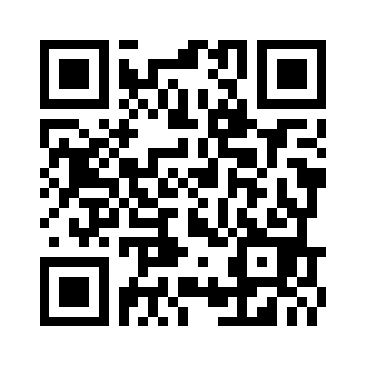
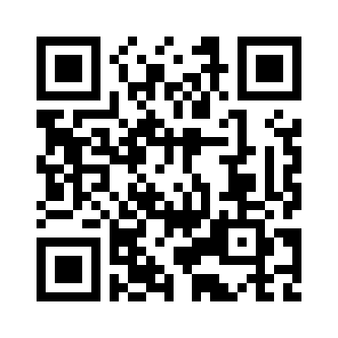
PLEASE FILL IN EVALUATION FORMS
FRIDAY, MAY 19th
SATURDAY, MAY 20th
https://survs.com/survey/cprwce7pi8
https://survs.com/survey/l9kksmlzd8
YOUR OPINION IS IMPORTANT!

Slide 18
THANK YOU TO OUR SPONSORS

